Slide 1
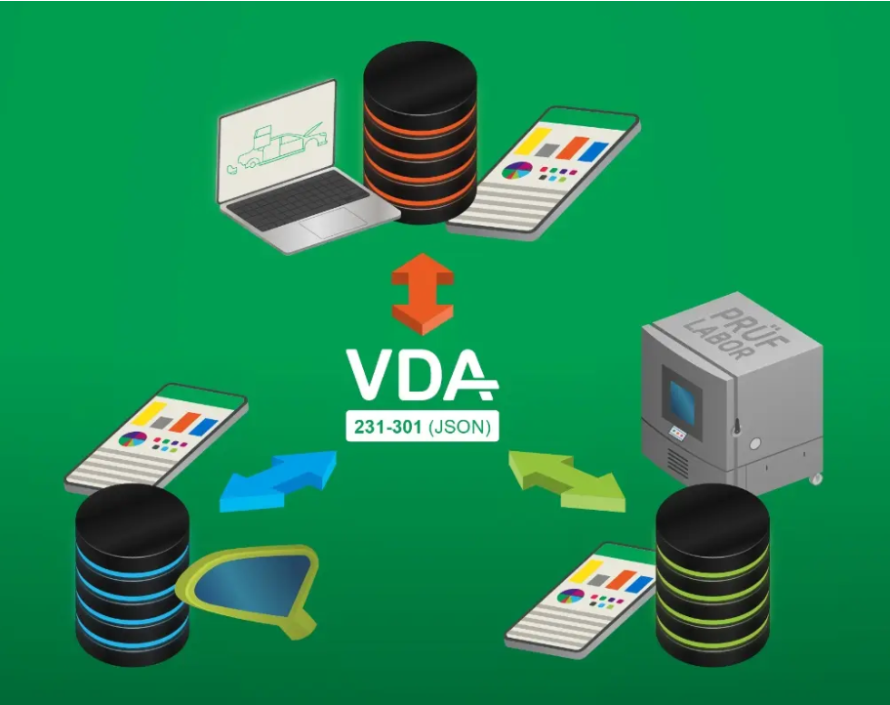
Agenda
Current Challenges Data Exchange of Materials
Complexity of Quality Assurance of Materials
Standardization VDA 231-300/301
Future ready: The base layers of Agentic AI in Material Data Exchange
How to contribute – next steps
Notes:
We will cover current challenges in quality assurance at Mercedes-Benz, the transformation to digital twins for smart QA, project insights on implementing this transformation, the rise of agentic AI within the software-defined industry, and the benefits of AI agents in QA and beyond.

Slide 2



Complexity of Traditional Material-Data-Exchange
Complex delivery regulations are passed on to the supply chain
Manual Process
Coordination Effort
Quality Risks
Manual steps:
• Test plans
• Result compilation
• Re‑typing
Partners:
• Suppliers
• Laboratory
• OEM
Inconsistency:
• Interpretation
• Errors
• Rework
No standardized, machine‑readable data

Slide 3



The Missing Link: Standardization
VDA 231‑300 & VDA 231‑301
Material Definition
Digital Test Results
Shared
Understanding
Material Definition:
VDA 231‑300
3D Data Record
JT / ISO 14306
Data Model:
VDA 231‑301
JSON Schema
Partners:
OEM
Suppliers
Laboratory
Machine‑readable • Validatable • Open
VDA 231‑300 defines what is tested – VDA 231‑301 defines how results are described. → Standardized, machine‑readable data, No re‑typing, No interpretation gaps
Notes:
VDA 231-301 enables the structured and digital mapping of test report results. In cooperation with the University of Stuttgart, IKTD, a general generic data model was developed that underlies all test report results. This was translated into a JSON schema, which was made freely available on Github to enable collaborative development. This allows a trustworthy data chain to be built without having to retype. Ideally, it extends from the testing device to the OEM.

